Slide 1
Breaking barriers:
uniting in support of our children and families
March 27, 2017
Carroll Schroeder

Slide 2
Barriers? What barriers?
Barriers to:
Getting kids what they need
In the amount they need
When they need it
So they can grow, develop and thrive
Notes:
When I started in this field in California, I had the great good fortune of working with a remarkable Director of Special Education in Davis. Hanna Bauer. Escaped Austria ahead of the Nazi Anschluss.
Came to the US with her husband Herbert, he a psychiatrist, she a psychologist. For Hanna, there were no barriers. For the kids in our fledgling 6-bed group home, kids who came from all over the state, there were no barriers to getting them what they needed. There was never a question of whether or not they were “our kids.” All kids were her kids. And she was an indomitable force in getting them what they needed. CHANGE

Slide 3
Barriers can be
Legal
Organizational
Personal
Notes:
Frequently we focus on breaking the legal and organizational barriers that ostensibly prevent us from working together to get kids what they need.
That’s worthy, and you’ll hear a lot about that today. CHANGE

Slide 4
Ultimately it comes down to the personal
If we want to break barriers, we will have to behave differently.
We have to be willing to confront and overcome the legal and organizational barriers that prevent kids from getting what they need, and we have to do that on a daily basis.
Notes:
If you wait for laws to change and organizations to change before you change your behavior, you will grow old and die. CHANGE

Slide 5
Ultimately it comes down to me
If I want to break barriers, I will have to behave differently.
If I am not willing to confront and overcome the legal and organizational barriers that prevent kids from getting what they need, the kids are screwed.
Notes:
It becomes my individual responsibility to do that. CHANGE

Slide 6

Usually…

Slide 7

Usually…

Slide 8
Usually…

Slide 9
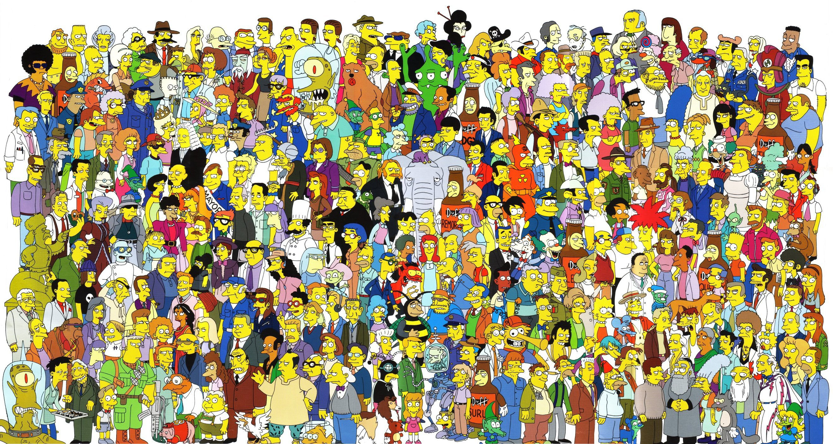

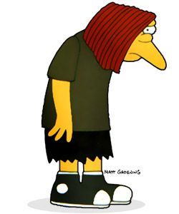


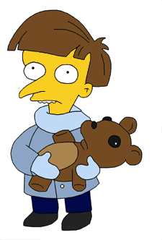






Usually…
Notes:
Pressures
Expectations
Limitations
Real and imagined
Coming from me and others
I CAN’T DO WHAT THEY ALL WANT ME TO DO!

Slide 10
If I’m going to overcome …
the legal and organizational barriers that prevent kids from getting what they need,
I have to put kids at the center of everything I do.
This is simple truth number 1.
Notes:
We already do that.
No you don’t. If you did, you wouldn’t be here trying to figure out how to break barriers.

Slide 11
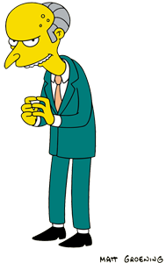

Because if I put the kids at the center…
Notes:
But when we put the kids and families at the center…
All of these people and organizations become my potential partners, and if they’re my potential partners rather than the source of my migraines, where are the barriers?

Slide 12
You can’t go it alone
This is simple truth number 2.
If I’m going to overcome the legal and organizational barriers that prevent kids from getting what they need, I’ll have to find the right partners…in the various systems…who are putting kids at the center.
Organizations don’t partner, people partner.
Notes:
Co Co Co story
A lot of the right people are sitting in this room

Slide 13
Bring resources to the table
This is simple truth number 3.
If I’m going to overcome the legal and organizational barriers that prevent kids from getting what they need, I’ll have to put in money or other resources.
Notes:
This is where it gets sticky.
Some of you are here to figure out if there’s some way to get somebody else to pay for something you currently have to pay for. Like mental health services.
You might call that breaking barriers. I would call it cost-shifting.

Slide 14
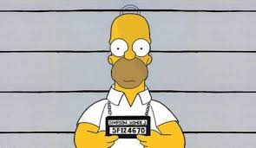
Barriers protect resources
I may have an employment or fiduciary obligation to ensure that money is spent judiciously and effectively.
Not only must I NOT spend money on certain things, I MUST spend money on certain other things.
And if I don’t…
Notes:
Barrels are barriers that protect wine. You have to top up the barrels from time to time or the wine will oxydize.
Government puts money in silos to ensure the money is spent for the purposes lawmakers intended.
Boards of directors restrict the use of reserves to ensure the fiscal viability of an organization.
You may have an employment or fiduciary obligation to ensure that money is spent judiciously and effectively.

Slide 15
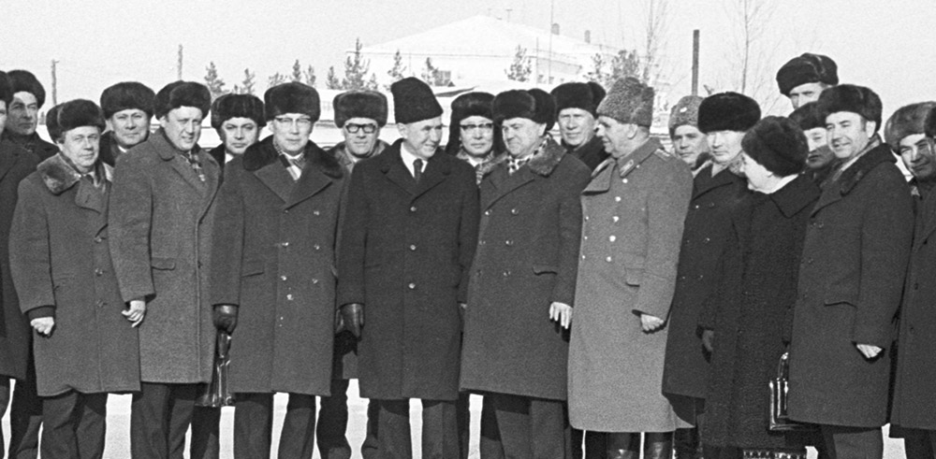
But…
If protecting resources is my goal, then I will forever be remembered as a successful bureaucrat, and a miserable apparatchik of a system that failed the kids it was designed to serve.
Notes:
You don’t want that.

Slide 16
Start one kid at a time
This is simple truth number 4.
I don’t have to change the whole system Day 1.
I need to make the system work for the kid I’m working for that day.
And I need to do it with my partners.
Notes:
As I work collaboratively, I discover the organizational and legal barriers that prevent kids from getting what they need.
Then, with my partners, I can go about breaking those barriers.
Remember, I can’t wait for the barriers to break to start. Let my work inform what needs to change legally and organizationally, then go about changing that.
STORY: Title 31 regulations

Slide 17
Have you ever wondered…
why it is some folks don’t do what you think they should do to overcome the legal and organizational barriers that prevent kids from getting what they need?
Why don’t they:
  Put kids at the center
  Partner
  Bring resources to the table
  Start one kid at a time?
Notes:
I behave in a way that puts kids at the center; partners with colleagues, parents, community;

Slide 18
Here’s why: They…
Can’t
Won’t
Don’t understand what to do.
Don’t have the capacity or authority to do it.
Don’t know how to do it.
Haven’t had the opportunity to do it.
Don’t have needed resources to do it.
Don’t agree on what to do.
Don’t feel it’s safe to do it.
Don’t have permission to do it.
Aren’t motivated to do it.
Notes:
“What am I supposed to be doing?”
That either it’s the right thing to do, or that the way you are going about it is correct.
b. May not physically, emotionally or intellectually be able to do it.
2. They may be punished if they do it.
c. Don’t have the knowledge or skills
3. Permission
d. Opportunity to do it in the past
e. Money, personnel, etc.
4. Either they’re not reinforced for doing it, they’re reinforced for not doing it, or they’re about to retire.
These are the personal barriers that need to be overcome so that we can get kids what they need.
Oh, and by the way, this goes for you and me too. CHANGE

Slide 19
Here’s why: I…
Can’t
Won’t
Don’t understand what to do.
Don’t have the capacity or authority to do it.
Don’t know how to do it.
Haven’t had the opportunity to do it.
Don’t have needed resources to do it.
Don’t agree on what to do.
Don’t feel it’s safe to do it.
Don’t have permission to do it.
Aren’t motivated to do it.
Notes:
And you’ll have to differentiate between what’s perceived and what’s real. CHANGE

Slide 20

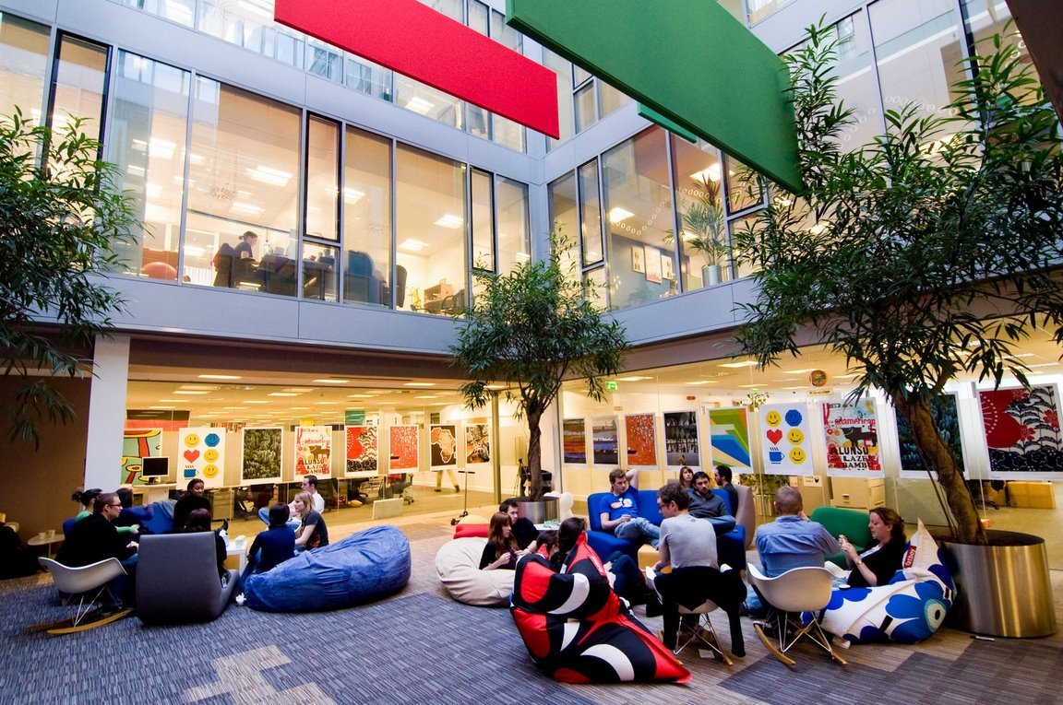
Bottom line:
My behavior is the only behavior I can truly control.
Laws and organizations provide frameworks for behavior.
The best organizations are structured to elicit the behavior that will make them successful.
Notes:
I can put kids at the center; partner with kids, parents, colleagues, the community; bring resources to the table; and start one kid at a time, with the intention of getting what they need; and address issues of can’t and won’t, Then, I can require my direct reports to do the same, and have them require their direct reports and so on down the line. And then I will have created a culture dedicated to ensuring kids get what they need. But what about beyond those areas over which I have authority.
(nothing)
Think Google. (CLICK) Just as Google structures its physical environment to elicit creative thinking and colleagial behavior, I can very intentionally create a culture of goal driven collaboration – within my organization and between people and organizations, all in the service of getting kids what they need.
If we do this (CLICK), we’ll break some barriers.

