Slide 1
San Francisco Unified School District Multi-Tiered Early Intervention & Support Program
April 28, 2017

Slide 2
Project Description
This project is intended to support students and families who continue to face barriers to school success particularly in settings which struggle to create and sustain supportive and nurturing school environments.

Slide 3
Goals or Purpose
By 2020, 85% of PreK/TK/K students exhibiting severe behaviors, will complete the SFUSD MTEISP SART (screening, assessment, referral, treatment) process and/or CARE (comprehensive assessment, research, and evaluation) program leading to interventions that result in improved classroom behavior.

Slide 4
San Francisco Partners
San Francisco Unified School District
Early Education Department
SF City/County
Department of Children, Youth & Family
SF City/County
Department of Public Health
Special Education Department
Support for Families of Children with Disabilities
Student, Family and Community Support Department
First 5 California
SF City/County
Mayor's Office
"Our Children Our Family"
SF City/County Office of Early Care and Education

Slide 5
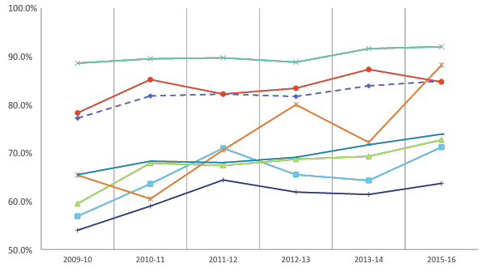
Cohort Graduation Rates by Subgroups, 2009-2015
The graduation rate is based on the four-year adjusted cohort, which is a group of students that could potentially graduate during a 4-year time period (grade 9 through grade 12).
Source: California Department of Education (June 2016)

Slide 6
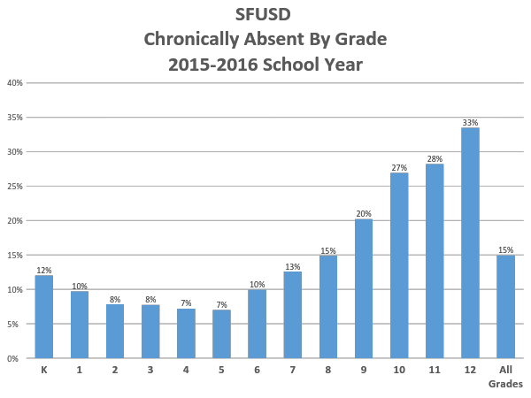
PreK Chronic Absenteeism Rate: 11.4%

Slide 7
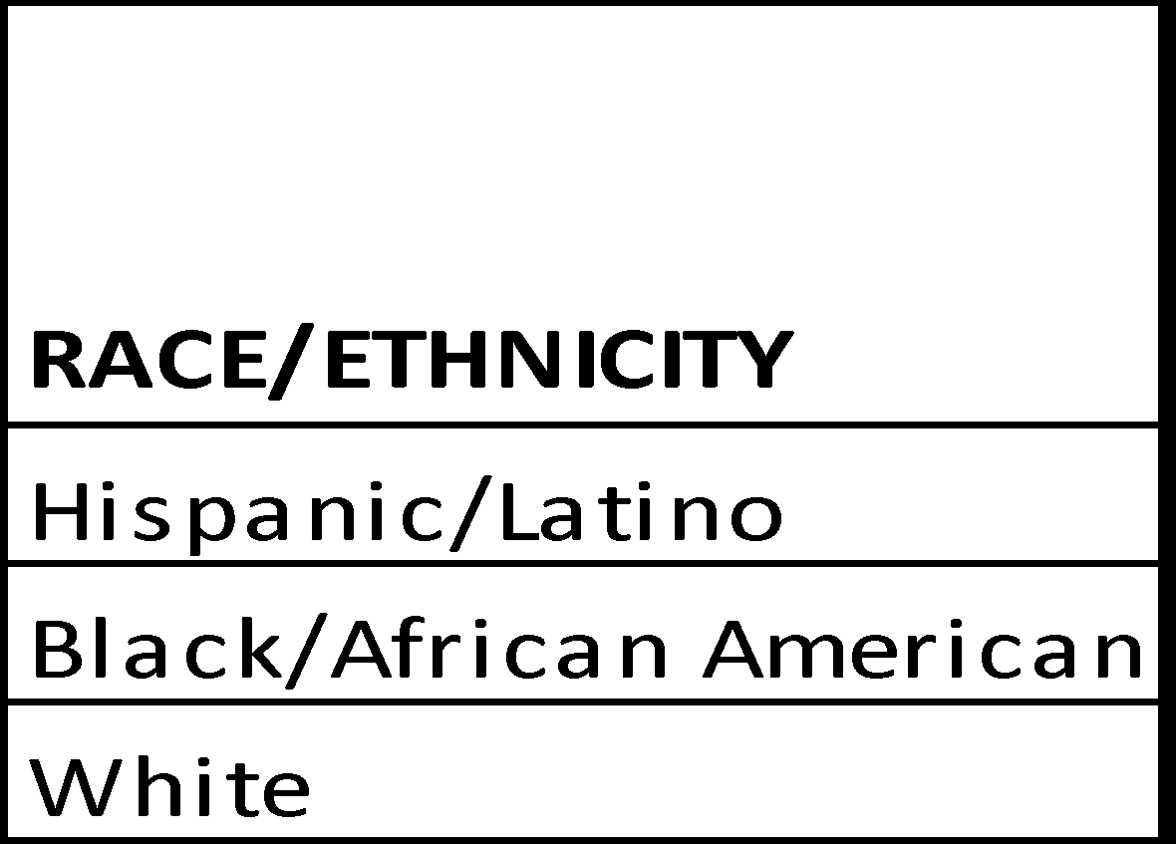
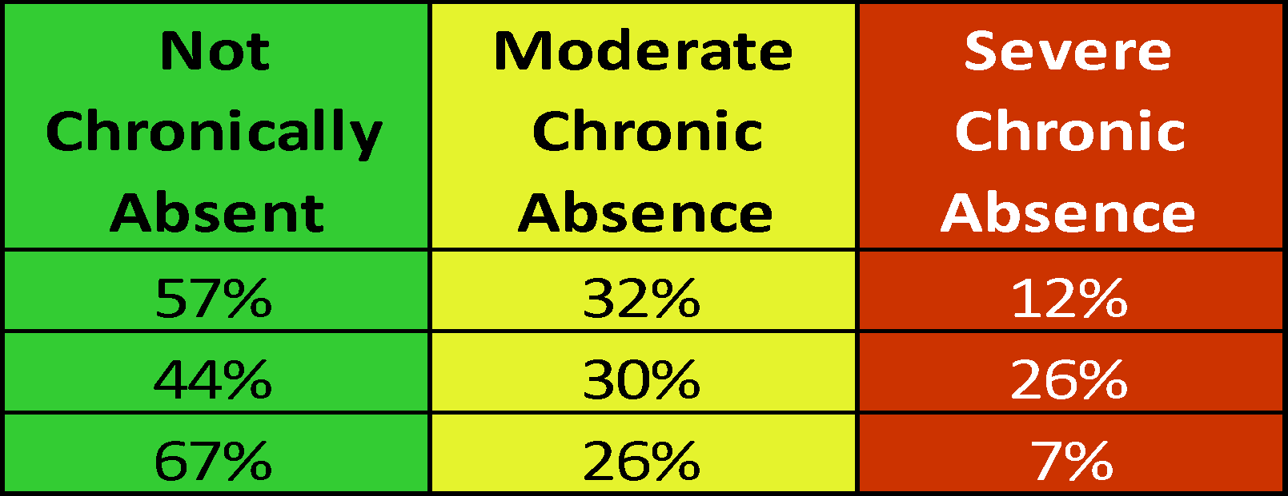
Pre K Students: Absence Levels by Ethnicity Percentages
SFUSD Pre K 2015-16 School Year

Slide 10
2012-16 K-Readiness Indicators
Assessment Tools | 2012-13 cohort | 2013-14 cohort | 2014-15 cohort | 2015-16 cohort
% of Students Assessed (K-Readiness) | 59% | 64% | 71% | 75%
K-Readiness (DRDP & PALS) | 37% | 45% | 50% | N/A
PALS only | 41% | 47% | 53% | 55%

Slide 11
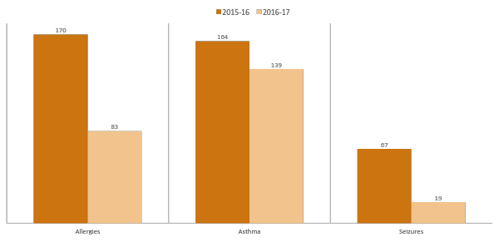
Students with Medical Conditions
2015-16= 379 Students 2016-17= 255 Students
Notes:
Total number of students for 2015-16 with medical conditions was 379. This year, with the current enrollment, 255 students have a medical condition, which includes asthma, any type of allergy, seizure, and other conditions. Majority is asthma but some students may have both allergy and asthma.

Slide 12
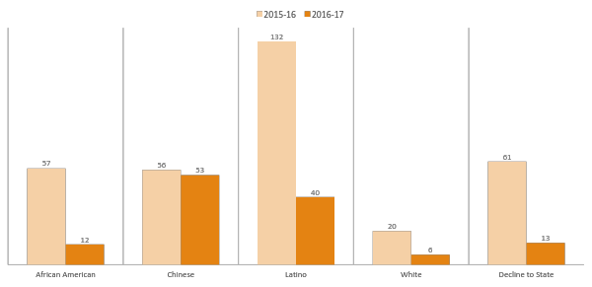
Students with Medical Conditions By Ethnicity
2015-16= 379 Students 2016-17= 255 Students
Notes:
This is the same group of students with medical conditions from previous slide with breakdown by ethnicity. These are the number of students for each of the ethnicities listed with any type of medical condition. For the 132 Latino students, the majority of the students had some type of allergy as their medical condition.

Slide 13
Factors Contributing to SE Needs
Foster Care/CPS/DHS involvement
Physical and/or Sexual Abuse
Neglect
Ruptures in attachment relationships
Incarceration of caregiver(s)
Disability (diagnosed/not diagnosed) affecting movement, interactions, learning, speech, etc.
Living in public housing, on public assistance
Low-income, working poor, living below poverty line
Housing instability
Natural disaster that affects home stability (e.g., fire, flooding, earthquake, etc.)
Unsanitary or unsafe housing (e.g., mold, rodent/insect infestation)
History of Substance Abuse in Home
Exposure to Community and/or Domestic Violence
Parents/Caregivers with a disability

Slide 14
Most Significant Challenges
Data, Reporting, and Analysis
Funding
Accountability: disparate interpretations of goals and expectations
Inconsistent Implementation of current strategies
Lack of Access to Mental Health Services
Cultural Competency, e.g. Community mistrust of systems

Slide 15
Targeted Population
PK, TK, and K students between the ages 3-5, who demonstrate serious behavior issues.

Slide 16
Most Impactful Solutions
Tying data together to analyze correlations and make decisions
Creating a way to collect hard data on PK student “suspensions”
Measuring Efficacy of Teaching Pyramid/PBIS in classrooms (Pre-Set/TFI)
Strengthening ways to ID students that need behavioral supports & measure progress
Finding effective ways to flag student attendance issues

Slide 17
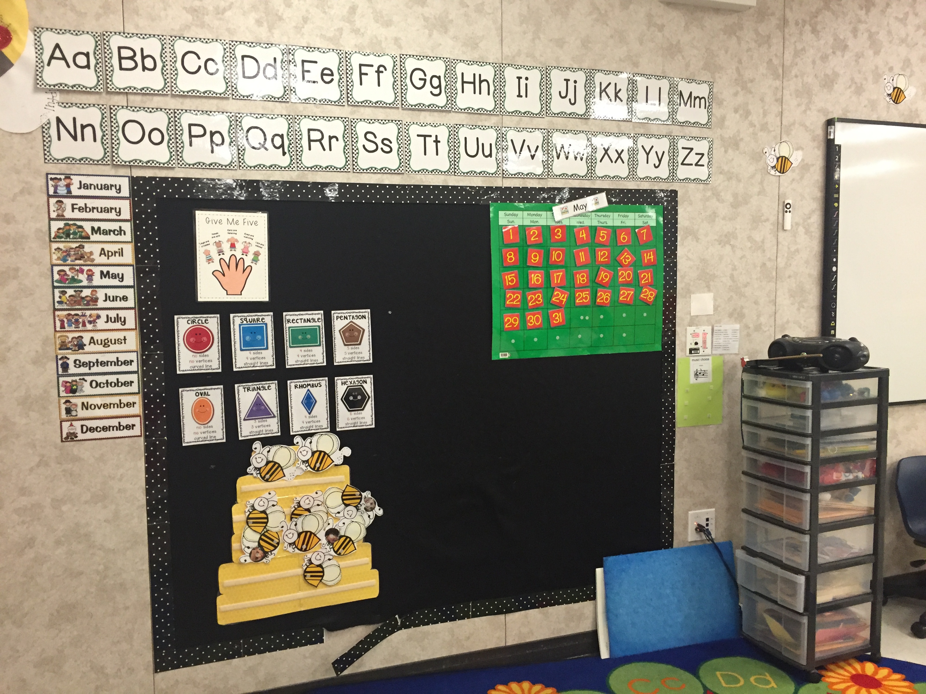
SART/CARE

Slide 18
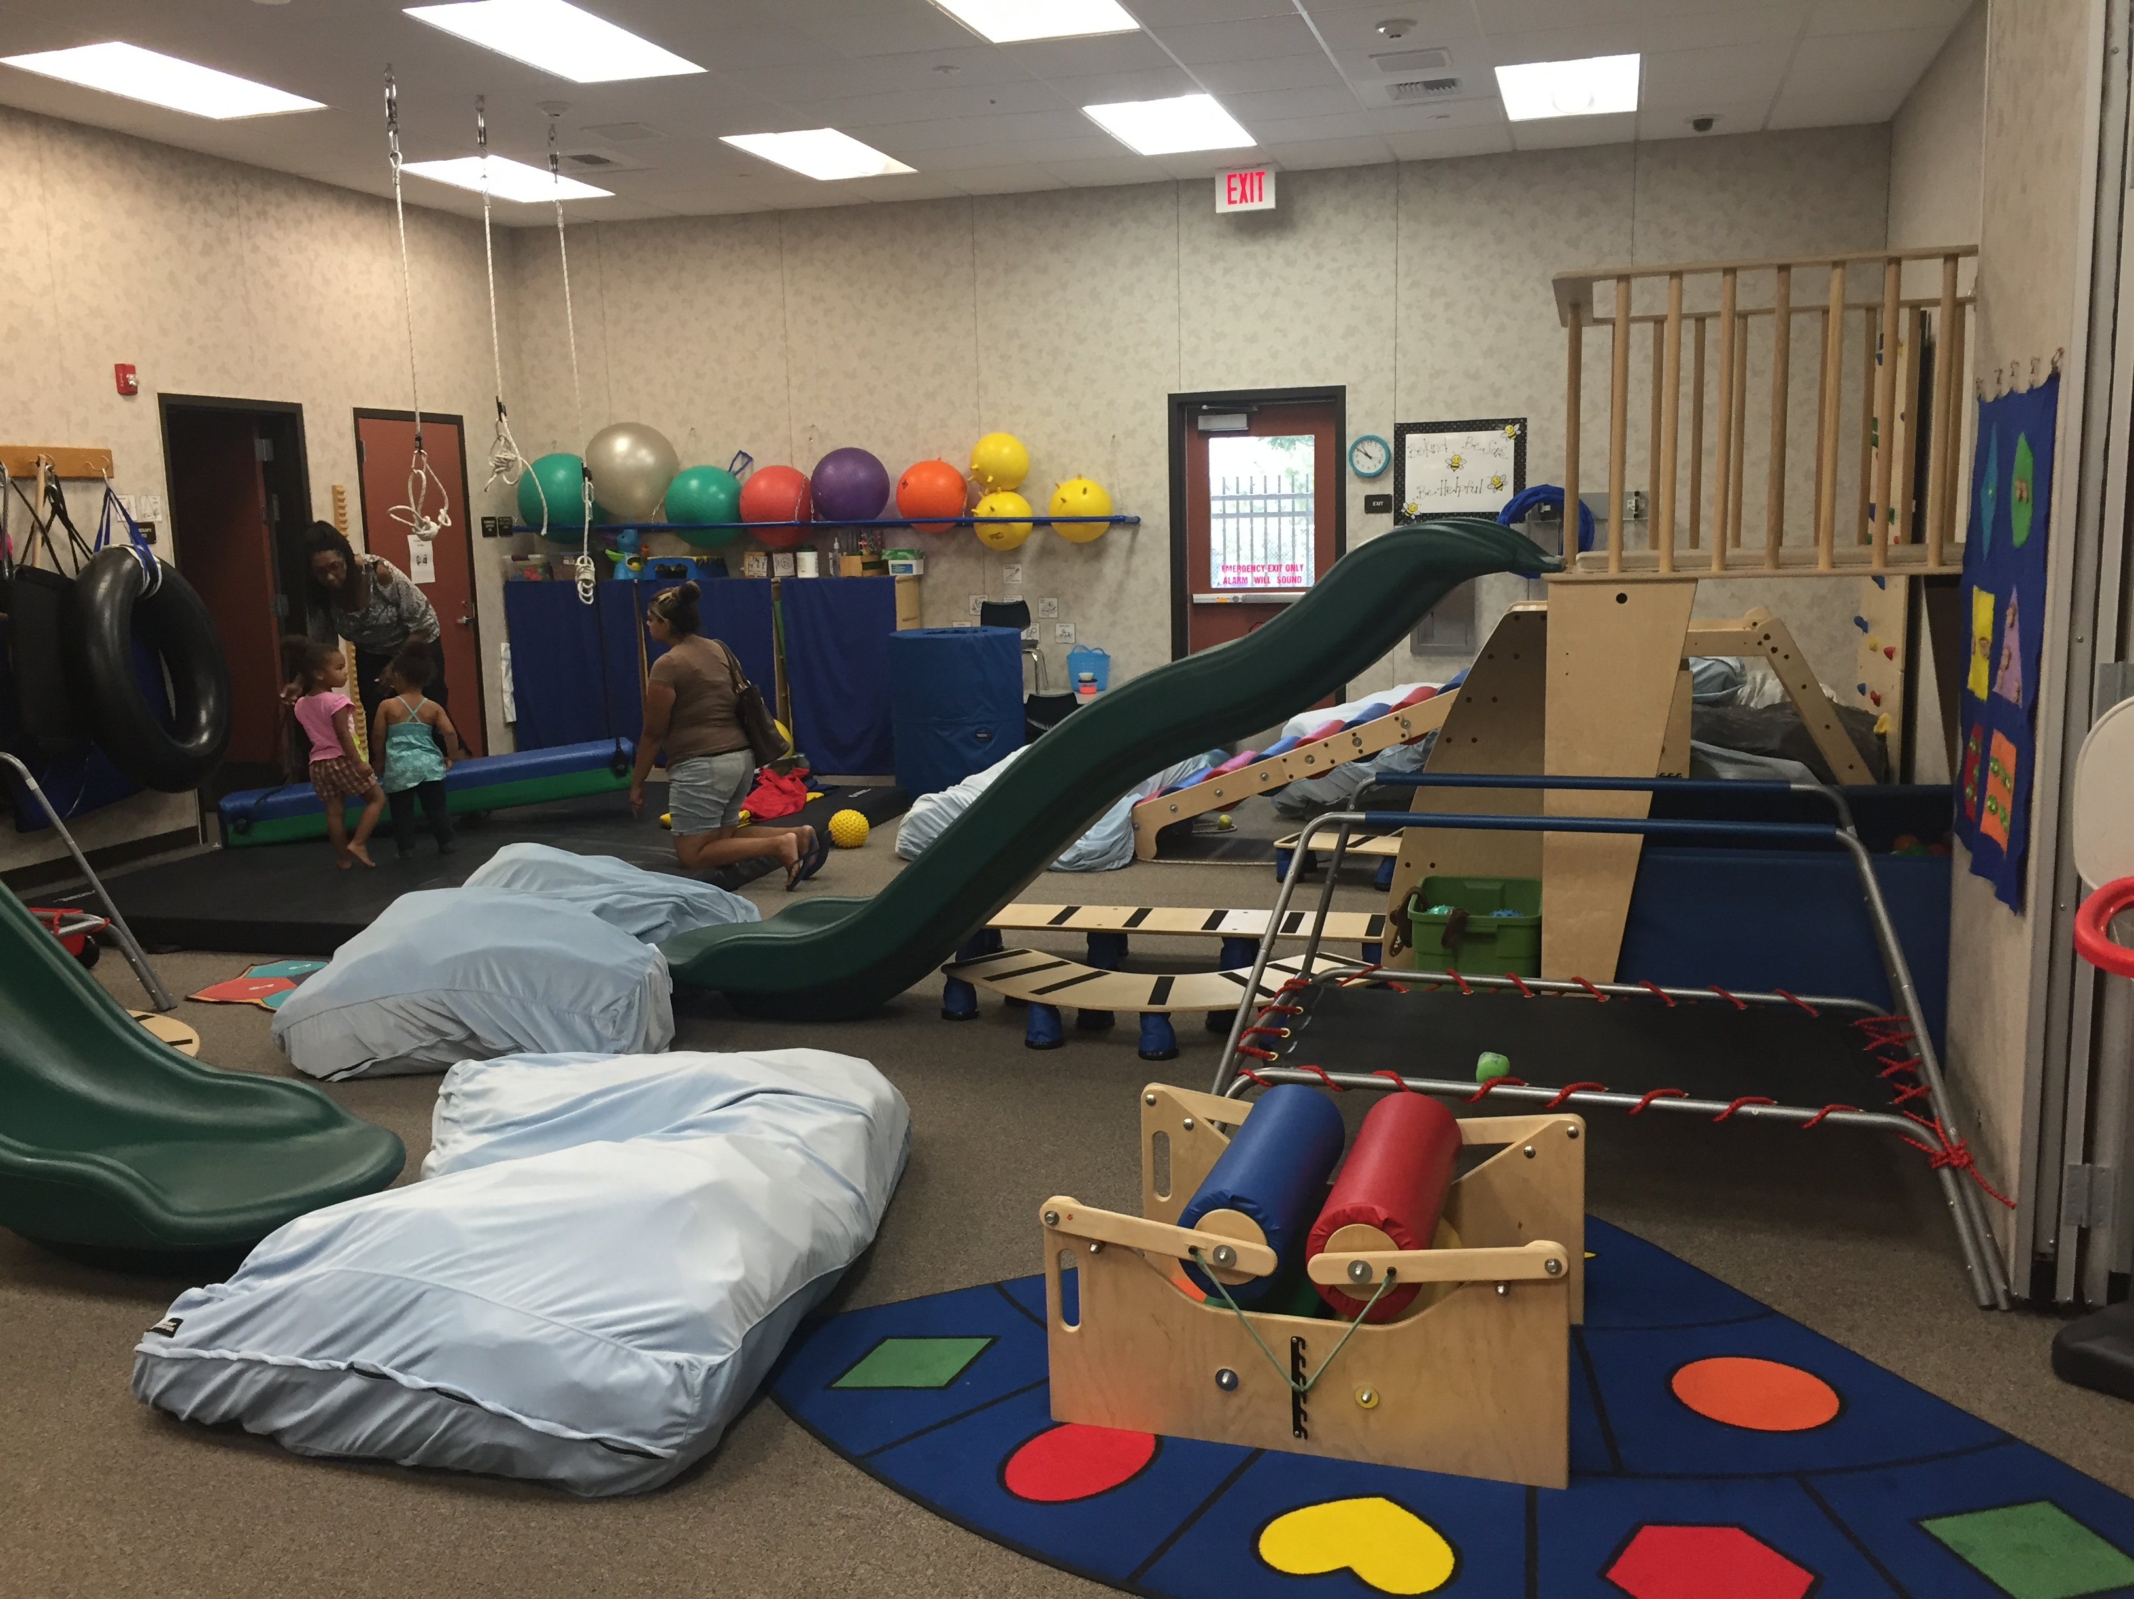
SART/CARE

Slide 19
Description of Next Steps
STEPS WHO BY WHEN
1. Finalize Budget Truitt/Yashar/Blanco 5/1/17
2. Finalize Plan Truitt/Yashar/Blanco 6/1/17
3. CENTER AVAILABLE FOR TOURS 7/1/17
4. Hire Staff SFUSD 5/1/17 - 9/30/17
5. Train Staff DMCC 7/1/17 – 6/30/18

Slide 20
What We are Most Excited About

