Slide 1
Breaking Barriers 2021
System of Care
Masterclass Series
April 21, 2021
Shared Leadership Toward one Child, One Family, One Plan
Notes:
SH

Slide 2
Welcome and Introductions
Steve Hornberger - Director, SDSU, Social Policy Institute
Richard Knecht - Managing Partner, Integrated Human Services Group
Today’s Guest Masters:
  Judy Webber, Child Welfare Director, Ventura County Health and Human Services
  Melissa Jacobs, Division Manager, Sacramento County Behavioral Health
Notes:
SH

Slide 3



Masterclass Series Sponsors
Notes:
SH

Slide 4
Our Purpose
Create a community of practice
Share resources in support of interconnected systems
Build space for informal peer-to-peer coaching
Inform policy as the field adapts and learns
Engage and strengthen community voices
Inform use and installation of best practices across the field
Masterclass webinars are skill-building opportunities for Integrated Systems implementers. The focus is on the technical elements of design and implementation, rather than policy.
Notes:
RK

Slide 5
Some California Context - AB 2083
Establishes required local department partners with options for others:
  Probation Departments
  Mental Health/Behavioral Health Departments
  Child Welfare/Social Service Departments
  Regional Centers
  County Offices of Education
58 county partnerships designing System of Care plans/Memoranda of Understanding
  Does not mandate local districts as signatories, although FYS partners are in some cases involved
Notes:
RK—
Invite inquiry on the fly and
Invite Chat as the ongoing conversation and learning clearinghouse. (Steve to Monitor)

Slide 6
Level Setting
State System of Care design (AB 2083) reflects research on Collective Impact
Breaking Barriers Four Pillars
  Shared Leadership
  Shared Data
  Shared Finance
  Shared Community
Resources at breakingbarriersca.org
  A quick look at the Breaking Barriers Toolkit Resources
  A quick look at the Breaking Barriers YouTube page
Notes:
RK

Slide 7

In February….
Notes:
SH

Slide 8

Notes:
SH

Slide 9
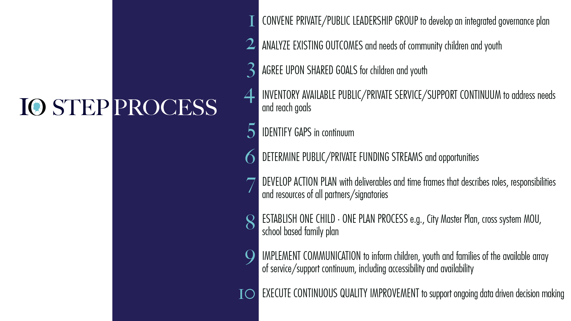
Notes:
SH

Slide 10
Four Anchors Support
System of Care Installation
Shared Leadership is the venue for working the 10 Steps outlined above.
In most counties, this will require an investment in a “CSOC Advisory Team” or a backbone organization to support the ILT.
Designate the administrative personnel to support the ILT.
Implementation Steps 1, 3, 5, and 7 are the first priorities in most communities.
Notes:
RK

Slide 11
What is Shared Leadership?
Shared leadership is largely dependent on a collective vision; and how the collective will pursue those goals.
Decision Making and Accountability - Being together in meetings is not enough. The group should identify how critical decisions are reached and how commitments are monitored.
Trust - Develops as all members keep their commitments and “show up” for one another.
Power - Systems often demand use of professional/role power. Collective, transformative work requires that we engage and share it with program participants and peers in leadership.
Consistency of Engagement - Meeting too infrequently in the early phases of collective work is a death sentence.
A System of Care is “Managing Risk, Reward, and Responsibility”
Notes:
RK

Slide 12
Today’s Masterclass Leaders
Judy Webber, Child Welfare Director, Ventura County Health and Human Services
Melissa Jacobs, Division Manager, Sacramento County Behavioral Health
Notes:
SH

Slide 13
Initial Questions:
What does Shared Leadership mean to you and/or your Interagency Partners?
In what ways has or does your ILT establish and monitor progress toward shared goals?
What analysis of gaps is occurring?
Notes:
SH

Slide 14
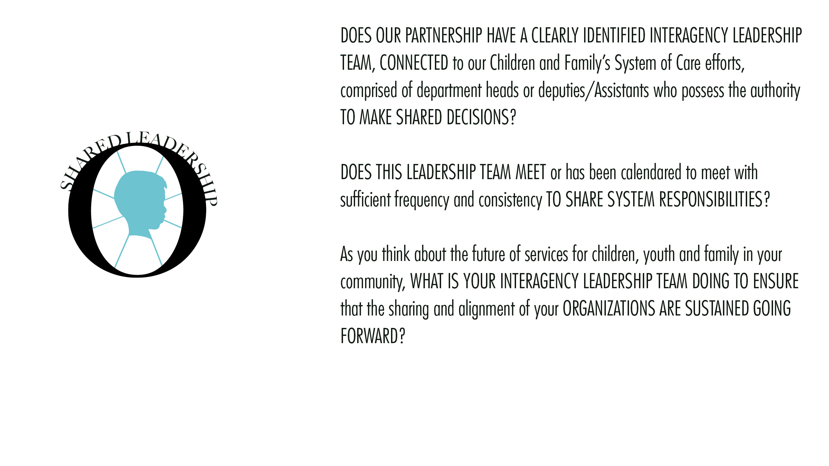
Notes:
SH

Slide 15
Reflections, Observations, or Inquiry
Shared Leadership
Notes:
RK

Slide 16
Reflections or Inquiry for June
Do our partners have a data sharing agreement necessary for effective service planning and case coordination? What are the actionable next steps?
Do our partners have a data sharing agreement for timely and effective use of outcomes data and performance indicators? What are the proposed next steps?
As the AB 2083 MOU is implemented, how will the ILT support data informed, decision making?
Notes:
RK

Slide 17
Masterclass Webinar Series
Wednesday, June 16th, 3:00 p.m. (PT): Shared Data
  Daniel Stein, National Implementation Collaborative
  Kate Cordell, Chapin Hall, Opeeka
Wednesday, August 18th, 3:00 p.m. (PT): Shared Finance
Wednesday, October 20th, 3:00 p.m. (PT): Shared Community
Masterclass webinars are skill-building for Integrated Systems implementers. The focus will be on the technical elements of design and implementation, rather than policy.

Slide 18
Registration and Inquiry Linkages
Register for the Masterclass Webinar Series (breakingbarriersca.org)
Contact us with any questions or for support at info@breakingbarriersca.org
Notes:
RK

Slide 19
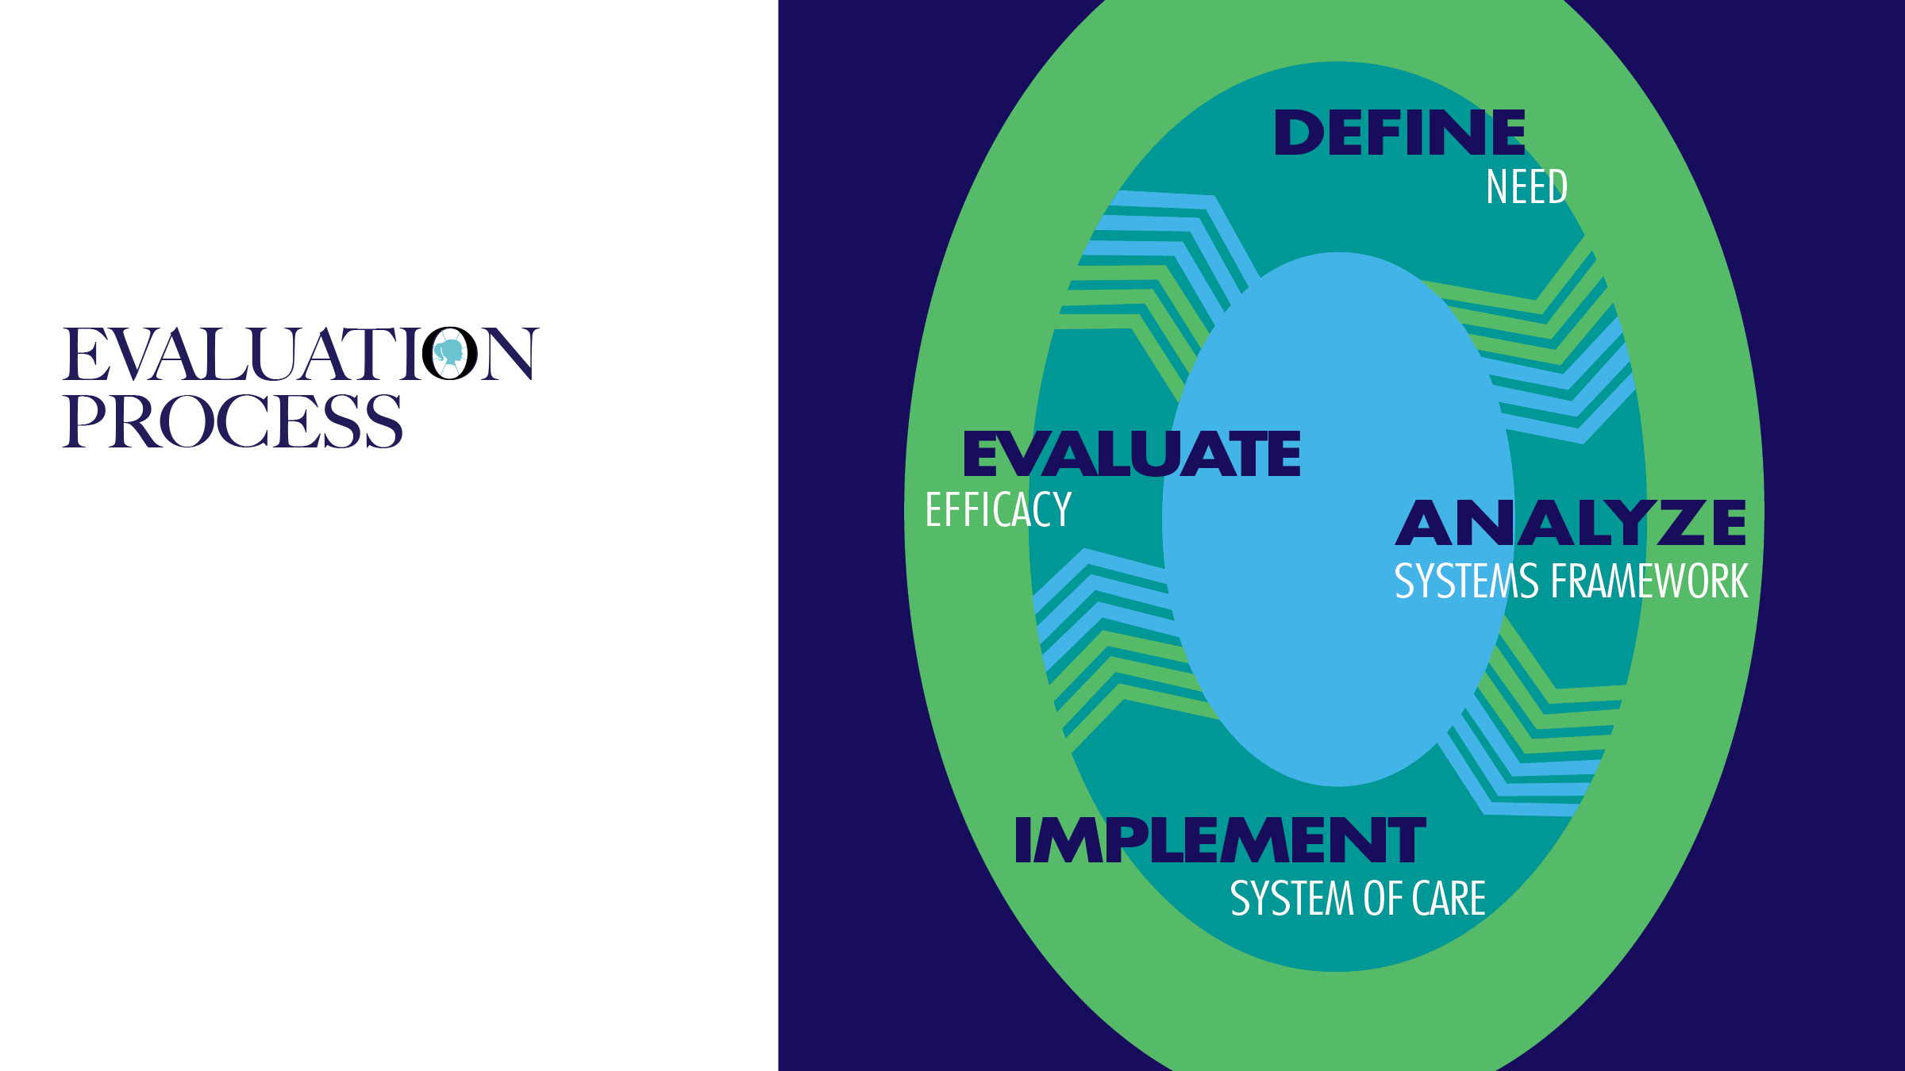
Notes:
EE
Note that it is similar to all universal CQI—Plan Do Study Act, Six Sigma, etc. ….Need evaluation of the system.
How will we achieve our goals from first step. At all levels…what is community impact.

Slide 20

Notes:
SH

