Slide 1
Drivers of Change: Health
Steve Hornberger, Briana Duffy
Breaking Barriers Symposium
April 28, 2017
Sacramento, CA
Notes:
National Institutes For Health Care Management (NIHCM). (2012). The concentration of health care spending: NIHCM foundation data brief July 2014. Retrieved from: http://www.nihcm.org/pdf/DataBrief3%20Final.pdf

Slide 2

Why Are We Here Today?

Slide 3
The Reality
No one system has the mandate, resources or reach to
address both person specific issues and the larger social
conditions that exacerbate these issues such as poverty,
racism, inadequate housing, homelessness, lack of
education, crime, and disparities.
“Health is a state of complete physical, mental and social wellbeing”
World Health Organization, April 7, 1948
Therefore, health is too important to be left to the health system alone

Slide 4
We Need To Work Together
If we are committed to improving the health and well being of Californian’s, everyone needs to play a part
We need to believe it is no longer necessary to try and prove that Behavioral Health and Social Determinants of Health matter– we know the critical role they play
We need to help make a very complicated delivery system easier to navigate
Silos need to come down and a willingness to work together on behalf of those we serve needs to be our goal!

Slide 5
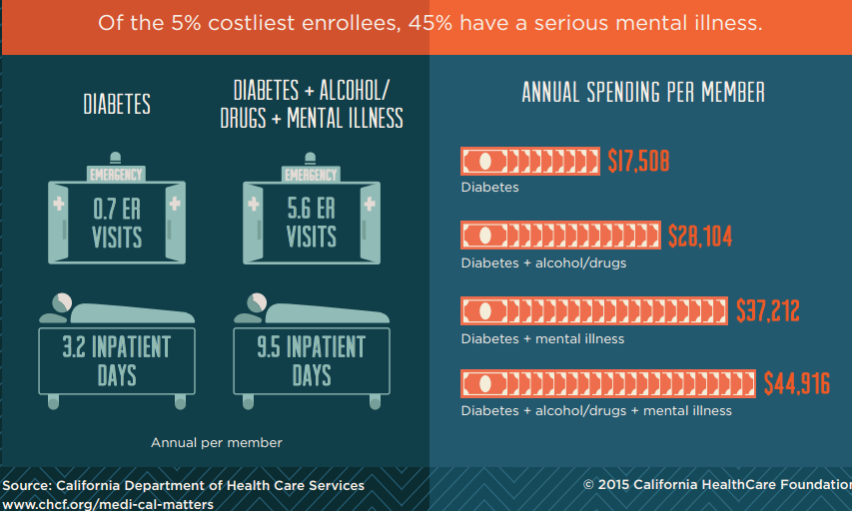
The CA Numbers

Slide 6

Focus On Reduction Of Health Care Costs & Integrated Care Models
Medical
Behavioral
Social
$40,682
average expenditure per person per year
50% of U.S. population accounts for only 3% of health care spending
$236
average expenditure per person per year
5% of U.S. population accounts for almost half of all health care spending
Social
Medical
Behavioral
© 2017. All Rights Reserved.

Slide 7
Integrated Care Coordination & Service Delivery Driven By The Triple Aim
Integrated Care Coordination
Management of care across health and human service system for selected consumers
Industry-wide focus on the Triple Aim, particularly for consumers with multiple chronic conditions
  Accountable care organizations (ACOs)
  Medical homes
  Health homes
Population Health
Experience Of Care
The Triple Aim
Per Capita Cost
Integrated Service Delivery
Providing range of health services in an integrated systems
  Coordinated service delivery
  Co-located service delivery
  Financially integrated service system
© 2017. All Rights Reserved.

Slide 8
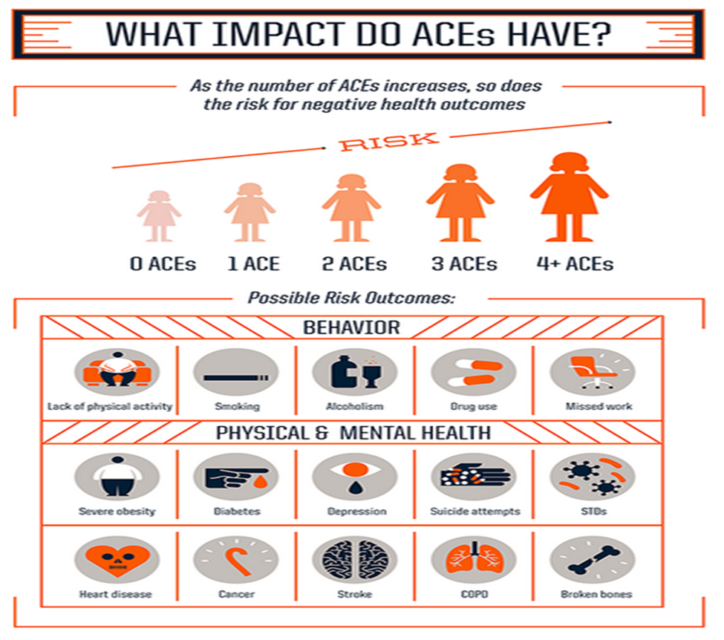
ACEs (Adverse Childhood Experiences):
Help Predict When a Larger System Approach is Needed
Trauma‐informed care considers the role that trauma plays in patients’ lives, shifting the question from “What is wrong with you?” to “What happened to you?”
SAMHSA Definition of Trauma: Individual trauma results from an event, series of events, or set of circumstances that is experienced by an individual as physically or emotionally harmful or life threatening and that has lasting adverse effects on the individual’s functioning and mental, physical, social, emotional, or spiritual well being.

Slide 9
Foster Care, Health, & Mental Health
Often removed from their families due to abuse and/or neglect, children in foster care often have health conditions that have been inconsistently treated or not addressed at all
30%-80% enter foster care with at least one untreated physical condition
Up to 80% of children in foster care have significant mental health issues, compared to approximately 18-22% of the general population
Notes:
http://www.ncsl.org/research/human-services/mental-health-and-foster-care.aspx

Slide 10
Foster Care, Health, & Mental Health
As a result of these increased mental health issues, foster youth are prescribed psychotropic medications at a much higher rate than non-foster youth, costing the state, through fee-for-service programs such as Medicaid, millions of dollars a year
The American Academy of Pediatrics, Healthy Foster Care American Initiative, identifies mental and behavioral health as the “greatest unmet heath need for children and teens in foster care”
Factors contributing to the mental and behavioral health of children and youth in foster care includes the history of complex trauma, frequently changing situations and transitions, broken family relationships, inconsistent and inadequate access to mental health services, and the over-prescription of psychotropic medications
Notes:
http://www.ncsl.org/research/human-services/mental-health-and-foster-care.aspx

Slide 11
Beacon’s Pediatric Psychotropic Drug Intervention Program (P-PDIP)
To promote proper prescribing of psychotropic drugs for children, Beacon and our MCO Partners in MA review high-risk prescribing practices when the PDIP algorithm identifies:
  Any child, six or under, prescribed an antipsychotic
  Any child, 15 or under, prescribed four or more medications, including antipsychotics
  Any child, 15 or under, prescribed one or more BH medications by a PCP or non-behavioral health prescriber (e.g., the child has multiple prescribers for multiple BH medications)
When concerning prescribing practices are identified, Beacon’s Child Psychiatrist outreaches to consult directly with the member’s prescriber. Reasons to consult with a prescriber may include, but are not limited to, any of the following:
  No preventative health visit in the last year
  Co-occurring medical and behavioral health conditions requiring coordination
  No evidence of any outpatient behavioral health visits in the past six months
  No evidence of a BH professional prescribing the antipsychotic or mood stabilizer
  More than one provider prescribing behavioral health medications

Slide 12
An Example of the System Working Together to Support Youth and Families in Foster Care
P-PDIP is a medication management/quality management program that identifies claims-based, medication-related problems through analytics, clinical review, and health informatics.
Designed to be complementary to traditional pharmacy-benefit management services.
Behavioral health focus, clinical review and incorporates both Behavioral and Medical claims information

Slide 13
Need For Children’s Services Integration
A more seamless and integrated system would provide shared infrastructure to identify concerns early and improve access to effective services for all youth in need, regardless of system involvement
The great challenge is getting all child-serving systems — behavioral health, juvenile justice, education, child welfare and others — to truly partner with one another in a way that more efficiently addresses the needs of at-risk youth
© 2017. All Rights Reserved.

Slide 14
County Providers
Organization of Mental Health Providers in CA
Providers are organized in response to different funding models
County Directly Operated Clinics
County
Contracted Agencies
FQHC’s
Private Providers who take Commercial AND some public insurance
Private Providers who take Commercial insurance ONLY
Providers who take cash payment only
Mild to Moderate

Slide 15
Children’s Services Integration Movement
Connecticut is implementing the Children’s Behavioral Health Plan. System partners are working toward better integration of finances, provider networks, and data. Access is being expanded so that there is “no wrong door” for receiving services.
New Jersey divisions of mental health and health are working together to begin strategic integrated healthcare initiatives
Notes:
http://jjie.org/2016/10/10/better-integrating-behavioral-health-juvenile-justice-systems-will-rescue-more-kids/
In Connecticut the implementation of the Children’s Behavioral Health Plan, system partners like the state Department of Children and Families (DCF) and the Judicial Branch’s Court Support Services Division (CSSD) are working toward better integration of finances, provider networks, and data. Access is being expanded so that there is “no wrong door” for receiving services.

Slide 16
Connecticut’s Children’s Behavioral Health Plan
System Organization, Financing, & Accountability
Focus on addressing financial and service delivery “silos”
Health Promotion, Prevention, & Early Identification
Caregivers, educational, health, and behavioral health professionals
Access To A Comprehensive Array Of Services & Supports
Assessment, address service gaps, focus on emergency alternatives to ER and hospitalization, enhance capacity of schools, coordinate suicide prevention activities
Pediatric Primary Care & Mental Health Care Integration
Incentives for co-location of services and physician training
Notes:
http://www.plan4children.org/wp-content/uploads/2016/03/PA-15-27-9-15-16-final.pdf

Slide 17
New Jersey Division Of Mental Health & Addiction Services Integrated Care Strategies
Partnering with the Division of Medical Assistance to develop Behavioral Health Homes (BHH)
The BHH is a high intensity service targeting those with the most need:
  Comprehensive care management
  Care coordination
  Health promotion
  Comprehensive transitional care (including appropriate follow-up from inpatient to other settings)
  Individual and family support
  Referral to community and social support services
  Use of health information to link services as feasible and appropriate
Behavioral Health in Primary Care Settings
  The New Jersey Division of Mental Health and Addiction Services (DMHAS) has explored several models of integration and continues to evaluate the needs of all populations
  DMHAS is currently working with several technical advisors, exploring how best to test and then implement integrated care in less intensive settings
© 2017. All Rights Reserved.

Slide 18
Moving Forward
Systems work best when individuals stop asking “What’s wrong with this child?” and start asking “What happened to this child?”
And the focus begins to shift from legal status, to the clinical profile of the child’s strengths and needs
This shift allows for a better recognition of trauma exposure and symptoms, and higher likelihood of referral to services and supports
Notes:
http://jjie.org/2016/10/10/better-integrating-behavioral-health-juvenile-justice-systems-will-rescue-more-kids

Slide 19
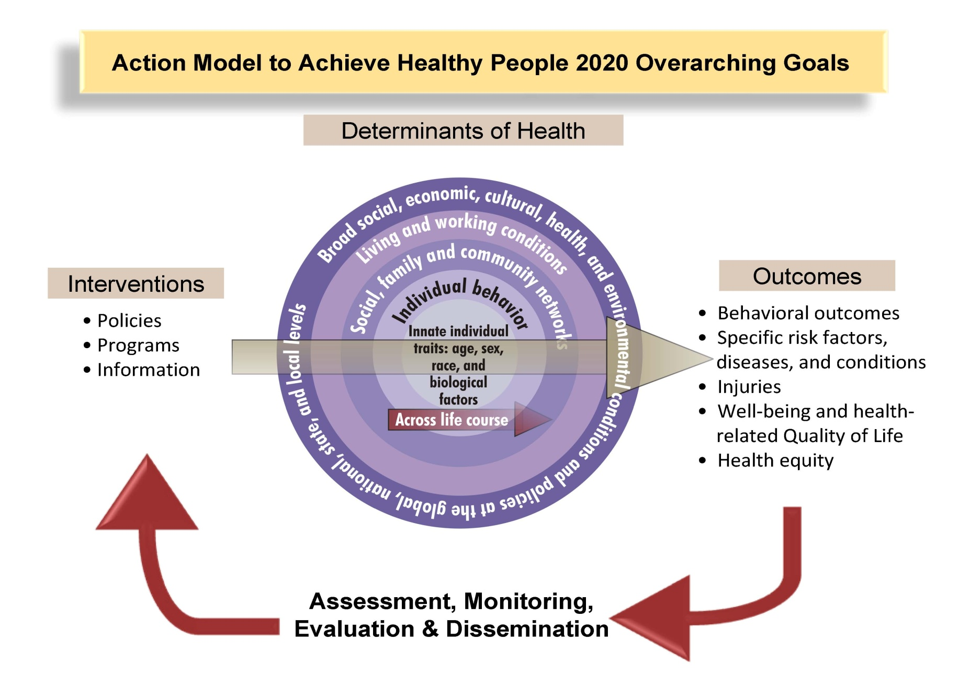
Healthy People 2020

Slide 20
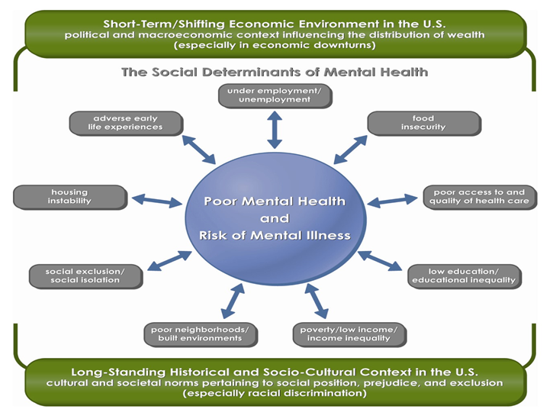
SDOH and Mental Health

Slide 21
Reduce health inequalities and
improve health and well-being for all.
Policy Goals
Create an enabling society that maximizes individual and community potential.
Ensure social justice, health
and sustainability are at heart of policies.
Policy objectives
1) Give every child the best start in life.
2) Enable all children, young people & adults to maximize their capabilities & control their lives.
3) Create fair employment & decent work for all.
4) Ensure healthy standard of living for all.
5) Create and develop
healthy and environmentally sustainable places & communities.
6) Strengthen the role and impact of ill-health prevention.
Policy mechanisms
Equality & health equity in all policies.
Effective evidence-based delivery systems.

Slide 22
California Accountable Communities for Health Initiative
Selects Six Communities to Receive $5.1 million
Funding will support cutting-edge multi-sector efforts to improve health outcomes
July 11, 2016. The California Accountable Communities for Health Initiative (CACHI) announced that six local communities from will receive up to $5.1 million in total funding to improve the health of Californians. Each will be awarded up to $850,000 over three years to advance common health goals and create a vision for a more expansive, connected, prevention-oriented health system. CACHI was established by The California Endowment, Blue Shield of California Foundation, Kaiser Permanente, and Sierra Health Foundation, to advance innovative health models focused on improving population health and reduce health disparities.
An ACH is a partnership between health systems, health care providers, health plans, public health departments, key community and social services organizations, schools, and other entities serving a particular geographic area for improving the health of the community with explicit attention to achieving greater health equity.
The following agencies, along with their partners, were selected to address pressing community priorities. In most cases, each site will target a specific geographic community.
  Imperial County Public Health Department, Imperial County
  Merced County Department of Public Health, Merced County
  Be There San Diego, San Diego County
  Dignity Health/St. Joseph’s Medical Center, San Joaquin County
  Santa Clara County Public Health Department, Santa Clara County
  Sonoma County Department of Health Services, Sonoma County

Slide 23
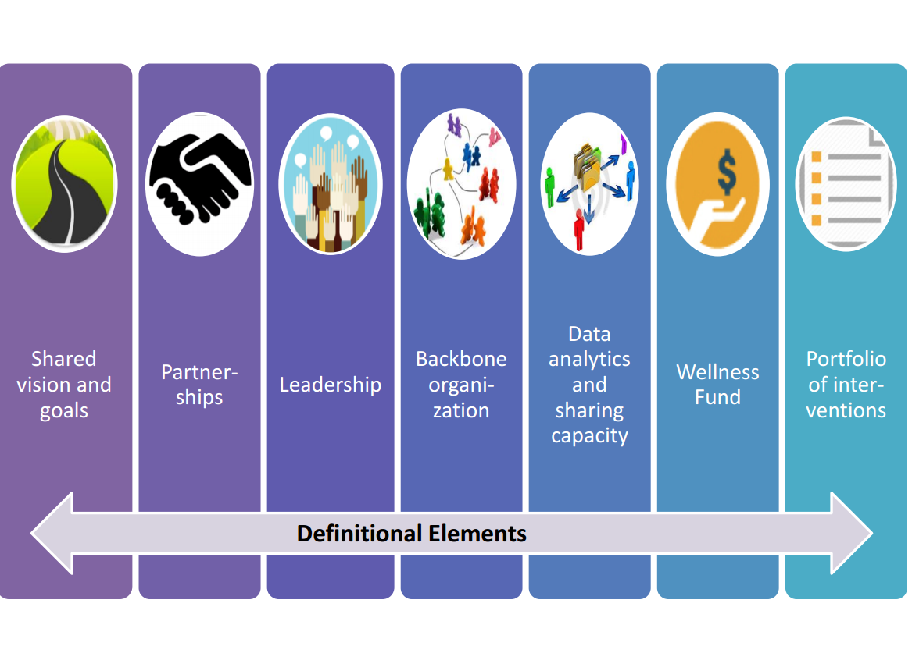
CACHI Definitional Elements

Slide 24
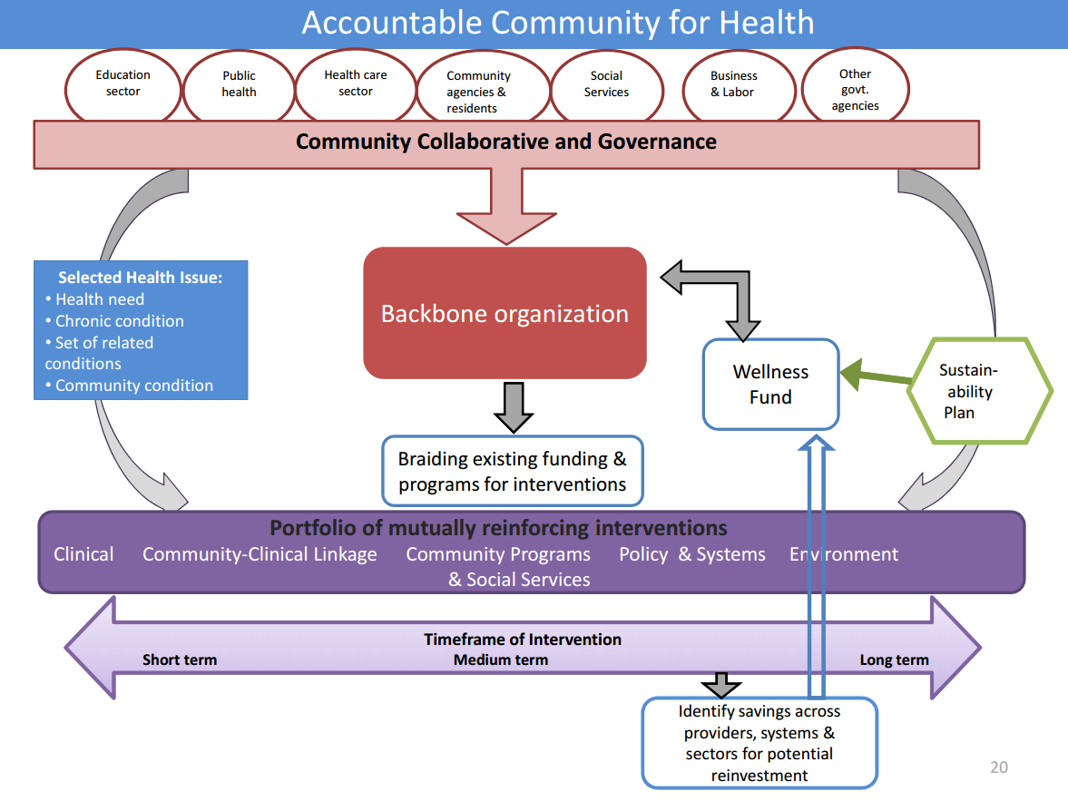
CACHI Structure

Slide 25

Understanding Success in Communities
Results
Goal or task accomplished
Relationships
The quality of the connections between the people engaged in the work
Dimensions
of
Success
Process
The way or spirit in which work is carried out
Source: Interaction Institute for Social Change

Slide 26
What does this mean for our work?
Results
Process
Relationships
Dimensions
of
Success
Results
Being comfortable with not having all the answers
“Nothing about this community, without this community”
Pace will be faster than you want it to; pace will be slower than you want it to
Relationships
Understanding community history and context
Politics and collaboration
Co-Production with community members
Balance of networking and connection and content
Change moves at the speed of trust
Process:
Paying close attention to the pedagogical aspects of QI
Joy in the process
Understanding general capacity, motivation for change, as well as QI
Interdependency of context and content
Source: Interaction Institute for Social Change

Slide 27
Driver Diagram
Secondary Drivers
Aim
By December 2016, we will increase socio-emotional wellbeing for children ages 0-8 in Dudley Square, Codman Square, and Mattapan by 30%.
Access to reliable, regularly updated indicators and data to inform collaboration
Integrated neighborhood child opportunity structure
Socially connected caregivers
Shared existing data from multiple sources and agreed upon indicators
Disseminate peer advocacy curriculum and meeting model
Peer to Peer Advocacy workshops, clinics
Improve neighborhood social cohesion
Systematic implementation of trauma- informed models in school settings
Improved classroom climates
Build family protective factors
Develop local community of practice
Network of engaged residents, stakeholders, and organizations
Financial opportunity centers in health centers to reduce material hardships
Improved understanding of child development by parents
Primary Drivers
Outcomes
Vision
Build community capacity, improve social cohesion, and strengthen family protective factors and neighborhood opportunity structures to maximize social- emotional competence and wellbeing for children and families.

Slide 28
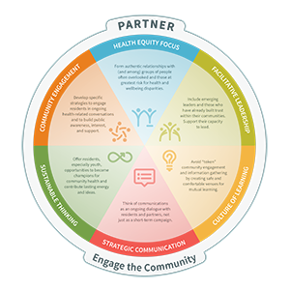
Active Living By Design

Slide 29
Roadmap of Medicaid Prevention Pathways
Today nearly 40% of children, over 35.5 million, are enrolled in Medicaid or CHIP
Roadmap includes 40 examples from over 23 states at an individual and/or an entire community or geographic area
Lists accelerators, barriers and conditions of success
      95202 = 73 yet 92606 = 88
A state example:
  SDOH screener co-located at Head Start sites

Slide 30
Roadmap of Medicaid Prevention Pathways
Accelerators:
  Champion
  Integrator
  Convening entity
  Infrastructure that encourages collaboration
  Robust data systems
  Learning collaboratives
  Practice transformation
Barriers:
  Difficult to establish a ROI for prevention
  Medicaid’s historical focus on clinical care not populations
  Concern about medical loss ratio
  Difficult to know where to begin
  Different sets of priorities
  No established working relationships
  Credentialing of non-traditional providers
  Enrollee churning
  Clinical staff uninformed about community linkages

Slide 31
Roadmap of Medicaid Prevention Pathways (continued)
Conditions of success:
  High level leadership
  State planning process
  Collaboration across state and community partners
  Recognition that State Medicaid agencies are one piece of the population health puzzle
All documents are available at: http://movinghealthcareupstream.org/innovations/pathways-through-medicaid-to-prevention

Slide 32
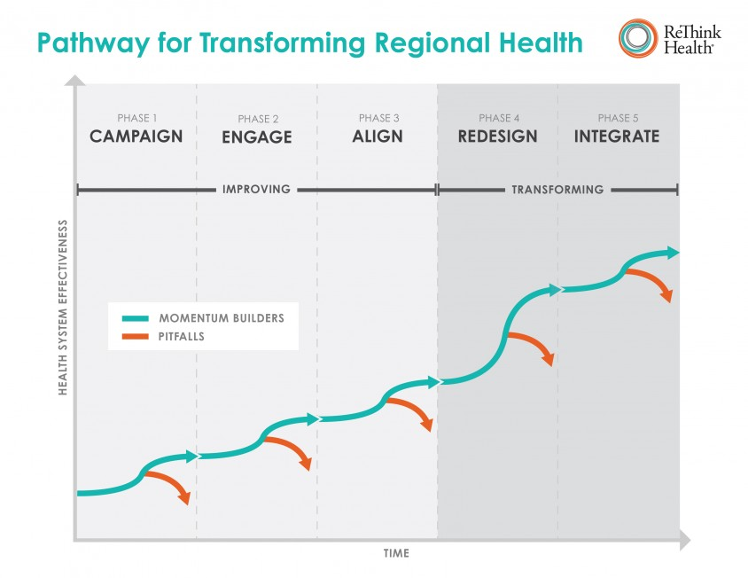
Rethink Health
Available at https://www.rethinkhealth.org/tools/stewardship-guide/

Slide 33
Rethink Health Financing Primer
The Financing Primer answers 7 key questions:
  IMPERATIVE: Why undertake such a daunting challenge?
  POTENTIAL: What is possible if we change where we invest rather than just how much?
  OPPORTUNITIES: What investment scenarios lead to markedly better outcomes?
  STRATEGIC CONTEXT: What does it take to do business differently—together?
  PRACTICE PROFILES: What are multi-sector partnerships doing to finance their health reform ventures?
  MECHANISMS: What options are emerging to finance long-term, health reform ventures?
  MOVEMENTS & INITIATIVES: How is a new generation of movements & initiatives advancing investment & financing?

Slide 34
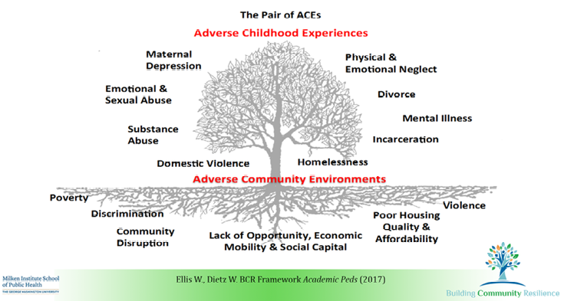
Building Community Resilience

Slide 35
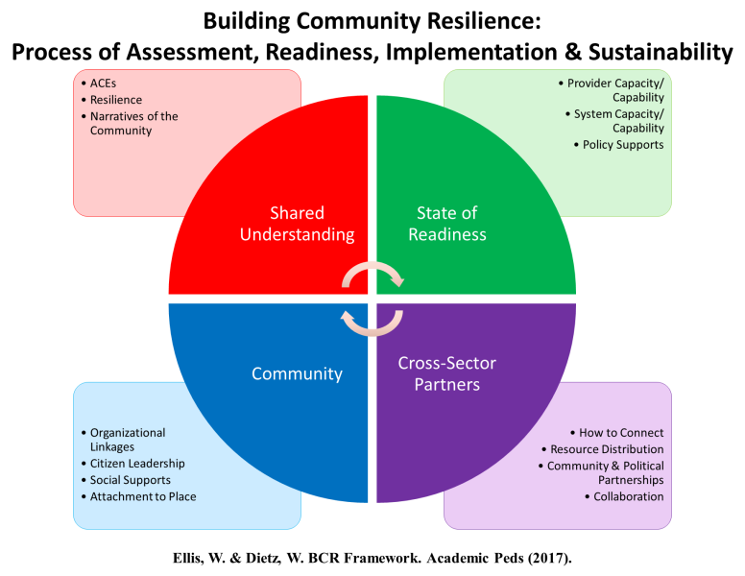
Building Community Resilience

Slide 36
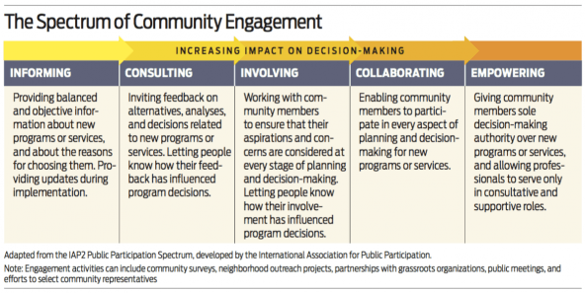
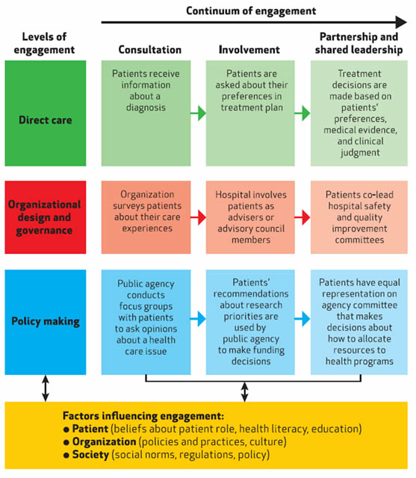
Engagement

Slide 37
Other Health Related Efforts
RWJF Culture of Health
Healthies Cities and Counties Challenge
County Health Rankings
Academy Health Toward a Data-Driven , Cross Sector, and Community–Led Transformation: Environmental Scan
Special Issue of Health Affairs 35, no.11 (2016)
LTSS No Wrong Door
Stakeholder Health
San Diego Live Well
Others?

Slide 38
Proposed Shared Vision
A community where all are safe, educated, healthy and well with a
sense of purpose, belonging and opportunities to achieve their aspirations.
Berwick on Era 3 https://youtu.be/H2SoHLHufv4

Slide 39
Contact Information
Steve Hornberger, Director
  SDSU Social Policy Institute
  shornberger@mail.sdsu.edu
  O: 619-594-2691 M: 301-602-1264
Briana Duffy, SVP Client Partnerships
Beacon Health Options
Briana.duffy@beaconhealthoptions.com
O: 562-246-3518 M: 781-710-2394

Slide 40
Appendix
Reference Materials

Slide 41
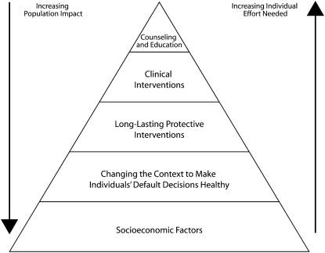
Health Impact Pyramid

Slide 42
Human Service Interventions

Slide 43
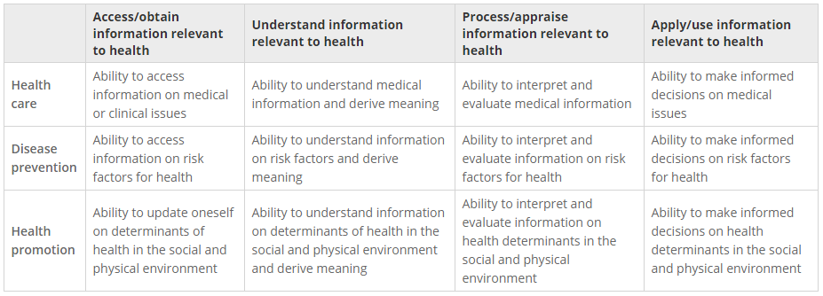
Health Literacy

Slide 44
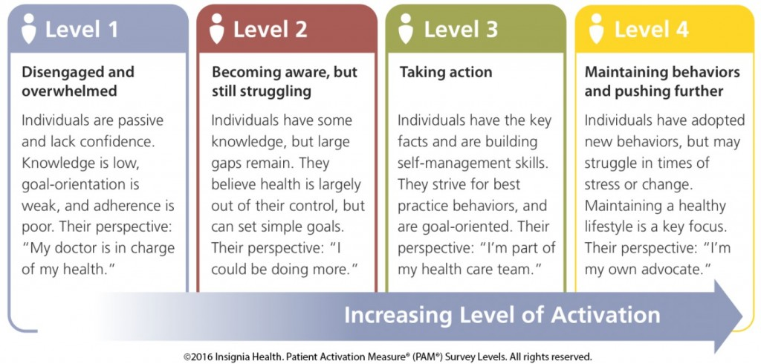
Patient Activation

Slide 45
CACHI RFP: Intervention/Service Descriptions
SERVICE | DESCRIPTION
Clinical Services | Clinical services (services delivered in the health care setting, including primary and coordinated care, primary prevention, and secondary prevention)
Community Programs/Social Services | Community programs, social services, etc. (programs that provide support to community members and take place outside of the health care system in community settings, schools, CBOs, etc.)
Community-Clinical Linkages | Community-clinical linkages (programs or activities that connect clinical services with community programs or social services e.g. community health workers; referral systems; screening for social determinants of health)
Public Policy and System Change | Public policy and system change (public and private practices, rules, laws, and regulatory changes, e.g. zoning rules, health plan incentives, etc.)
Environments | Environments (changes in social, community, or physical environments that support healthy behaviors, e.g. walking and biking trails)

