Slide 1
Fresno County Health and Wellness Collaborative

Slide 2
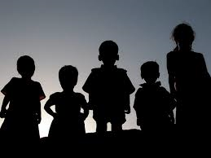
National Center for Children in Poverty
1 in 5 children birth to 18 has a diagnosable mental disorder.
1 in 10 youth has serious mental health problems that are severe enough to impair how they function at home, in school, or in the community.

Slide 3
Fresno County Superintendent of Schools Mental Health Classrooms
Discussion and Questions

Slide 4
Bessel Van Der Kolk, M.D.
Heather T. Forbes, LCSW
Dr. Bruce Perry, M.D., Ph.D

Slide 5
“The trauma caused by childhood neglect, sexual or domestic abuse, and war wreaks havoc in our bodies says Bessel Van der Kolk, The Body Keeps the Score….Van der Kolk draws on thirty years of experience to argue powerfully that trauma is one of the West’s most urgent public health issues…”
Shaoni Bhattacharya, New Scientist

Slide 6
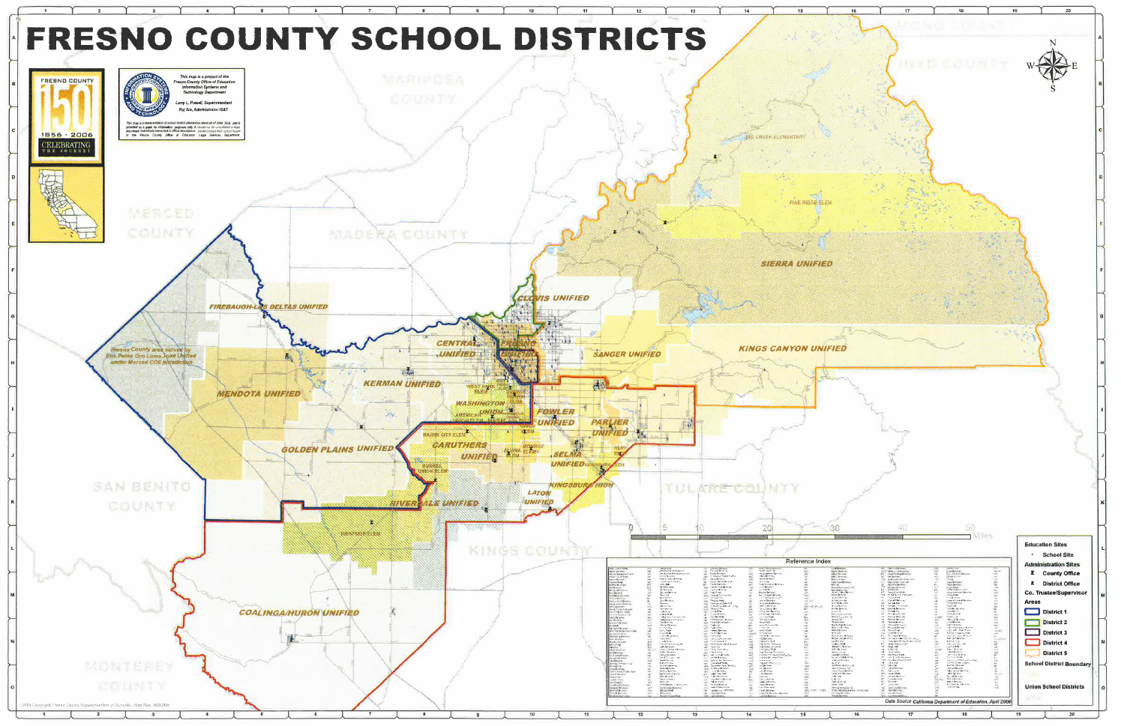

Slide 7
Breaking Barriers Collaboration
Serve all Fresno County Children

Slide 8
Breaking Barrier Accomplishments
ACCOMPLISHMENTS

Slide 9
Program Review
FIRST STEPS TO SUCCESS
10 week intensive intervention program to address social, emotional and behavioral needs of 3-6 year olds.

Slide 10
Barriers
Gap in Service Delivery
Sharing information
Funding

Slide 11
Cont.
NEXT STEPS

Slide 12
FUNDING Serve all Fresno County Children

Slide 13
Thank you

