Slide 1
Breaking Barriers Annual Conference 2017
Napa County
Team
Pamela Ptacek Blatt, SELPA Director
Jim Diel, Clinical Director, County Mental Health
Jeannie Puhger, Prevention, Health & Wellness Manager

Slide 2
Mission
Develop a seamless, articulated, coordinated service model to meet the needs of ALL children and youth in Napa County.

Slide 3
Participating Agencies
ALDEA (mental health provider)
Napa County Probation Department
Napa County HHSA - Alcohol & Drug Services
Napa County HHSA – Public Health
Napa County HHSA - Mental Health
Prevention Health and Wellness (NCOE)
Court and Community Schools (NCOE)
Infant/Preschool Program (NCOE)
SELPA
SELPA Member LEAs

Slide 4
Where Are We Now?
Multiples agencies delivering services to children, youth and families in varied community settings (school, home, co-location and organizational)
Services target individual agency mandates and regulations (not a bad thing), but are not coordinated and do not take advantage of leveraging resources.
Data collection does not compare “apples to apples” we are all measuring our own outcomes which makes it hard to determine effectiveness.

Slide 5
Where Do We Want to Be?
Leverage resources where possible
Shared responsiveness to community needs within the scope of responsibility (Mental Health, Education, Special Education, Alcohol & Drug, etc.)
Identify and engage all relevant participants to maximize the scope of the effort
Target efforts on shared outcomes and measure impact using common tools of measurement
System planning & implementation to coordinate services to maximize capacity & improve outcomes

Slide 6
How Are We Going to Get There?
Outreach to potentially interested parties (school districts, community providers)
Establish shared data and screening norms through workgroup
Identify areas of synergy where we can leverage resources or increase impact of existing services
Look for opportunities where we could find growth in this shared system

Slide 7
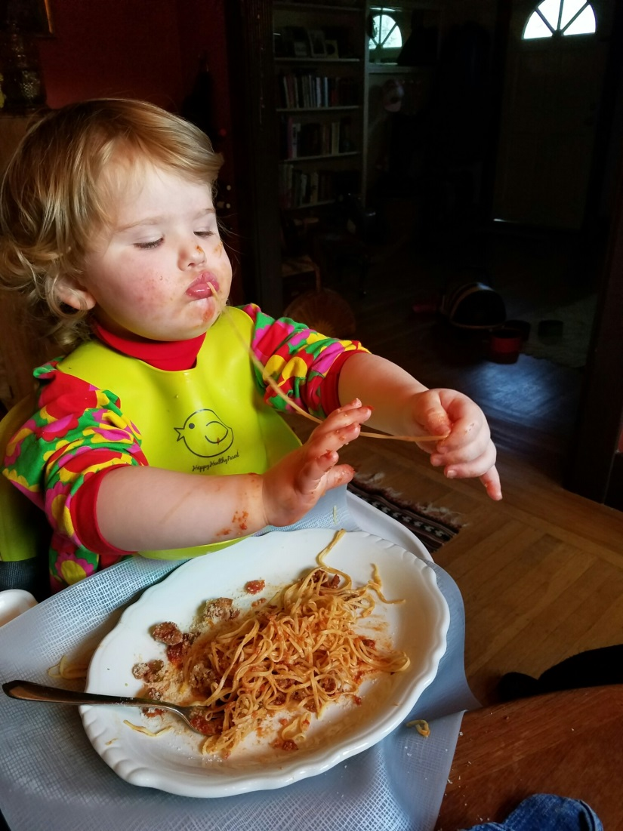
Questions and Answers

Slide 8
Contact Information
Pamela Ptacek Blatt
pblatt@napacoe.org
Jim Diel
jim.diel@countyofnapa.org
Jeannie Puhger
jpuhger@napacoe.org

