Slide 1
BREAKING BARRIERS West Contra Costa Unified School District

Slide 2
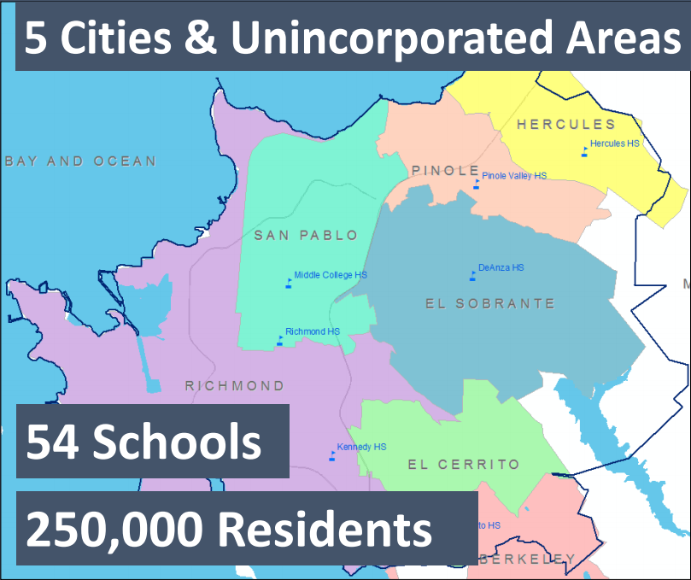
WCCUSD Demographics

Slide 3
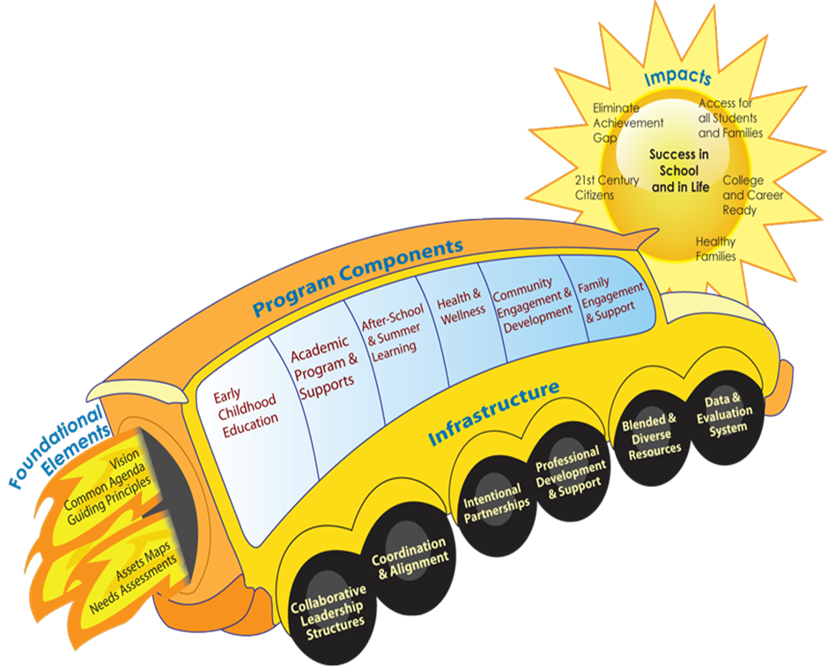
West County Full Service Community School- A Strategic Vehicle For Climate Transformation
Full Service Community Schools (FSCS) aims to increase student and family well-being by offering access to high quality coordination of comprehensive academic, social, emotional, and health services that supports preparing students to be college, career, and community ready.
This integrated, comprehensive, coordinated collaboration aims at achieving educational success, well-being and self-efficacy for students, families and communities. This collaborative effort geared towards school and community transformation includes West Contra Costa Unified School District, Contra Costa County, local cities, community-based organizations, and residents.

Slide 4
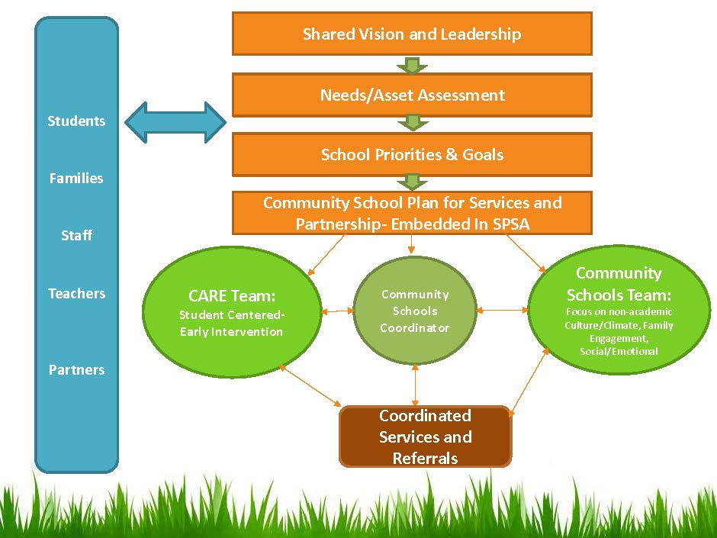
Full Service Community Schools In Action

Slide 5
Why Full Service Community Schools?

Slide 6
Goal & Purpose
WCCUSD proposes to develop a
District Screening, Assessment, Referral, & Treatment Team (SART) to provide Tier II Intervention to support the highest needs students districtwide.
The SART team will provide additional district level assessment and support to coordinate services among schools and community resources for students, and provide professional development to school administrators, teachers and paraprofessionals.
This closes the gap in our current Full Service Community Schools implementation—creating a central support process to address our highest needs students

Slide 7
Targeted Population
Although WCCUSD has many programs and collaborative partners, there is the need for coordinated services district-wide that will include systematic screening procedures, a comprehensive referral system, comprehensive assessment, and treatment based on data.
The initial focus for SART will be on Tier 2 elementary school students to provide early identification and treatment. Particularly focused on students whose school sites are struggling to serve them with their current resources and student support services structure.
In addition, our highest needs communities include Richmond and San Pablo. Case Management & Mental Health support will be prioritized towards serving students and families in those schools.

Slide 8
SART Team Members & Collaborative Partners
SART Coordinator
Occupational Therapist
Physical Therapist
Speech/Language Specialist
Public Health Nurse
Psychologist
Mental Health Clinicians- District & County
Clinical Social Workers- District & County
Pediatrician
Probation Office
Social Services
School Resource Officers
School Community Outreach Worker

Slide 9
SCREENING
A comprehensive initial referral system will be implemented at the elementary schools
Screening provides the means to determine the depth of assessment needed
Screening instruments may include: Ages & Stages Questionnaire, AML Behavior Checklist, Teacher-Child Rating Scale (T-CRS), Parents Appraisal of Children’s Experiences, BASC, Achenbach, etc.

Slide 10
ASSESSMENT
Assessment will include an in-depth evaluation of the child’s needs including:
Data collection
Background Information
Behavioral Observations in multiple settings
Clinical Interviews with the child, caregivers, and collateral Informants (teachers, etc.)
Administration of standardized measures

Slide 11
REFERRAL
Team compiles assessment information and makes recommendations to parents/caregivers/teachers
Team identifies appropriate resources and providers to meet the student’s needs
Team identifies training and consultation needs for teachers and caregivers

Slide 12
SERVICES & TREATMENT
Treatment may include:
Behavior Interventions
School Support
Occupational/Language Therapy
Trauma Informed Training & Consultation
Parent Education/Parent Support
Counseling/Mental Health Services
Crisis Intervention Services

Slide 13
Intended Outcomes
Data Collection is a critical part of intervention programs
SART will develop a data base for students screened, services provided, and evaluation.
Program evaluation is not seen as an activity that occurs once a year, but rather as an ongoing process.

Slide 14
Needs:
Match:
SART Coordinator
Intervention Teams- Social Work & Mental Health:
3 Social Workers
3-0.5 FTE Mental Health Clinicians
Data System
WCCUSD Occupational Therapist
WCCUSD: Physical Therapist
WCCUSD: Speech/Language Specialist
WCCUSD: Nurse
WCCUSD: Psychologist
Contra Costa Health Services: 3-0.5 FTE Mental Health Clinicians

Slide 15
Most Significant Challenges
Establishing new system in large district spanning multiple municipalities
Funding for mental health services that serve non medi-cal students
Funding & resources to serve the whole family
Providing capacity building to sites to ensure successful student integration despite high needs

Slide 16
Most Impactful Solutions
Multi-sector team to support integration of services across systems
Creates opportunity for family systems support
Allows for central support for highest needs students while also supporting students staying in the least restrictive environment
Provides mental health services and case management support for highest needs students regardless of insurance coverage

Slide 17
Description of WCCUSD Next Steps
STEPS BY WHEN
1. Secure Funding ASAP
2. Develop SART Referral System Summer 2017
3. Convene Partners & Plan Summer 2017
4. Train WCCUSD Staff Summer/Fall 2017

